Slide 1
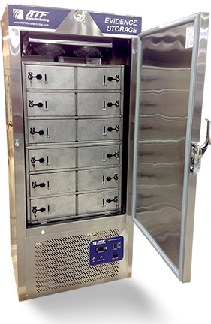
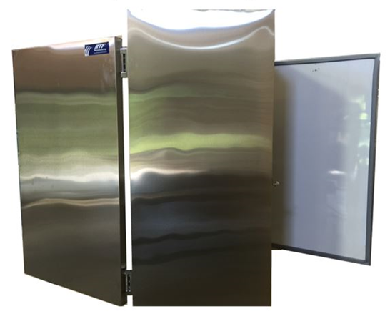
Our Sponsor Today is RTF - Building Refrigerated Evidence Storage Lockers that meet and exceed CALEA, ISO 17020 /17025, FBI-QAS and NIST guidelines.
Notes:
RTF small very specialized business in upstate NY (Hudson). Specializing in customized state of the art refrigeration, freezers and lyophilization technologies.
Combined concepts of small secure storage compartments within reefer and freezers.
Very interested in partnering with LEA CSI / Academic Research to study lyophilization evidence storage (short and long term)

Slide 2
Quiz Question

Slide 3
Background
Majority of non conformances, errors or mistakes caused by not following good procedures, using bad procedures or no procedures.
High risk people contact processes = NonCons
Risk vulnerability assessment: R = F x C
ASQ

Slide 4
Curricula materials https://www.dropbox.com/sh/joppbt3sgc9dz1m/AAD27AyZPPVloGh8TlMrZBdZa?dl=0
PPT lecture
NIST publications and guidance
Biological Evidence Preservation: Considerations for Policy Makers. http://nvlpubs.nist.gov/nistpubs/ir/2015/NIST.IR.8048.pdf
Biological Evidence Preservation Handbook. https://www.nist.gov/sites/default/files/documents/forensics/NIST-IR-7928.pdf
5.8 Evidence handling procedure
Active / passive voice
Dale, Becker 2014 Forensic Laboratory Management: Applying Business Principles
Floor diagram
Process Flow Chart
Verbal articulation audio
Dropbox link:

Slide 5
Why write a procedure?
Do what you say, say what you do, do it right.
Evidence is mishandled (lost, degraded, contaminated, no chain).
You do not want headlines “Evidence compromised in ___ homicide.”
ISO 17025 / 020 and CALEA mandate written policies and procedures.
NIST provides excellence guidance that should be followed for biological evidence handlers and policy makers.
Essential for high risk / people contact tasks both administrative and technical.
Foundation for training curricula and competency assessment.
Secure inconclusive evidence (mixtures, degraded etc.) for new technologies
Recommend a national standard procedure and evidence storage capabilities.

Slide 6
Evidence handling basics
DNA evidence is invisible
Separate Ks and Qs
Chain of Custody: P and P
Authorized People and Places
High Risk? YES
High frequency, high consequence
People contact
Material Transaction Errors
Data Transaction Errors
Very difficult to determine causation and corrective action
All cases are unique. ASK YOUR LAB FOR GUIDANCE!

Slide 7
Procedure design strategy
Modify Existing
Modify another agency SOP
Start new

Slide 8
Procedure Writing Overview
Can be used for any procedure (tech or admin)
Desk audit (off site)
Surveillance audit
Interview all stakeholders
Collect all documents
Process Flow Chart
Verbal Articulation
Write procedure
Active voice
Assign authority and responsibilities to position titles
Identify conformance and non conformance
Outline by position titles
Continual improvement (Deming: Plan, Do, Check , Act)
When in doubt, contact laboratory

Slide 9
Desk audit (usually off site)
Review all existing documents
Policies, Procedures, Documents, Records, Software
Do you understand how it is done?
Who is responsible for a task?
Who authorizes persons to perform task?
Is competence defined?
Are acceptable outcomes defined?

Slide 10
Observe and interview
Surveillance audit
Follow evidence from:
CSI, PD, LAB, PD, Court, PD Long Term
Done same way as shown in desk audit?
Observe tasks being performed
Personnel following existing procedure?
Responsibilities and Authorities identified?
Horizontal and vertical linkages?
Collect documents

Slide 11
Process Flow Chart PFC
Keep it simple
Identify major steps
CSI, PD, LAB, PD, Court, PD
Identify authorized Places
Identify authorized personnel (job titles)
Identify Authorities and Authorizations and competencies
Identify documents and software
Horizontal / Vertical linkage
PFC - Copy.JPG

Slide 12
Evidence Handling or CoC
Sequential series of tasks and outcomes
Auth/Limited
Place
D&S
D&S
D&S
Auth/Limited
Pos/Title
QA Metrics
Time
$
QA good
QA bad
QA Metrics
Time
$
QA good
QA bad
QA Metrics
Time
$
QA good
QA bad
Major Errors =
Material transactions
Data Transactions
By People
Notes:
WHO can handle evidence = authorized list with authorizations
WHO authorizes???
PLACES approved for storage = authorized list
How Limited
How Secured

Slide 13
Verbal Articulation
If you can explain the procedure clearly, then you know it.
Take turns with all team members
Take the lumps out of the gravy
DCSO EVIDENCE INTAKE A&B.m4a

Slide 14
Write the procedure
Follow PFC
Copy verbal articulation
Include documents and software
Use a standard format e.g.
Mission
Policy
Assign authorities and responsibilities
Procedure
Reference documents and software
Reference horizontal linkages to other Policies and procedures (Security, Barcode LIMS, CSI etc.)
Write in Active Voice (Subject / Verb / Object)
Dale_ActivePassiveVoice[1].pdf

Slide 15
Controls Vertical / Horizontal Audits
CSI
Recognize
Collect
Protect
(CDL)
PD
Store
CC
Lab
Analyze & Store
CC
PD
Store
CC
Court
CC
Long Term Storage
CC
Plan
Do
Check
Act
Notes:
Audit for CoC documentation (transfer receipts and inventory records)
Pick 1 or more items or case and go cradle to grave
Pick 1 or more Places and inspect all items
Pick 1 or more Persons and inspect all items

Slide 16
Examples of good procedures
5_8 Handling_of_Test_Items_Draft_3Feb_wmd.pdf
Floor.pdf
4__6_Purchasing[2].pdf

Slide 17
Conclusion
Decide redo or new SOP
Form a Team (SME, QA/Supv, Writer)
Desk audit
Observe
Process Flow Chart
Verbal Articulate
Write Active Voice
Training
BOLO “Material / Data Transactions” + People
Dry, refrigerate, freeze, separate BioEvidence Ks and Qs
Controls, Vertical/Horizontal audits, PDCA for continual improvement
Regularly confer with CSI/LAB/LEA

Slide 18
Quiz Answer

Slide 19
Thank you for attending today’s webinar.
May We Please Answer Any Questions?
W. Mark Dale, MBA, ASQCQA, RTF Forensic Sales, 518-265-0774, wmarkdale@gmail.com
Brian Hade and Ashley Finck, RTF Manufacturing Company, LLC, 793 Route 66, Hudson, NY 12534 Phone: 518-828-2198, ​Toll Free: 800-836-0744, Fax: 518-828-2257, ​Email: info@rtfmanufacturing.com

